Slide 1
Learning & Development
Renew
Feb 2026

Slide 2

Overview of Webinars
1 Core HR (Nov)
2 Handling Issues (Jan)
3 Learning & Development – in small organisations
Developing your people
Understanding effective learning
Raising Questions

Slide 3

Aim for today
Unpacking ‘Development’
What development priorities?
Learning
Why is learning important?
How we learn effectively

Slide 4
Building an Individual Development Plan
Performance review meetings to discuss gaps in current delivery
Feedback from colleagues, clients and stakeholders
Knowledge, compliance and experience gaps for aspirational role
Key step changes – eg line management responsibility
Current role
Future / stretch
Individual
Organisational
Hard
Soft

Slide 5
Building an Individual Development Plan
Current role
Future / stretch
Personal motivations, interests and aptitudes with specific reference to how these might be expressed at work
Wider environment
Organisational change and complementarity within team
NB: nature of small organisations
Individual
Organisational
Hard
Soft

Slide 6
Building an Individual Development Plan
Current role
Future / stretch
Individual
Organisational
Knowledge, Expertise, Compliance, Skills
Relatively quantifiable, objective and verifiable by testing and exposure
Behavioural, Competence, Values
Longer term, requiring practice and feedback to develop and embed
Hard
Soft

Slide 7
Identifying priorities
Behavioural
Effectiveness
Impact
Collaboration
Creativity
Fun
Effectiveness
Considerations
Focused vs scatter gun
Concrete vs ill defined
Tracked vs drifting
Technical
Competence
Quality
Speed
Context:
Career stage
Role stage
Personal life
Time

Slide 8
High performance behavioural capabilities:
Where do I focus next?
Communication
Leadership
Appreciation
Trust
Collaboration
Strategic insight
Influencing
Decisiveness
Feedback
Vision

Slide 9
Questions / Comments

Slide 10
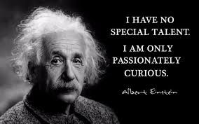
Why learn?
Discipleship
Stewardship
Sanctification
Service

Slide 11
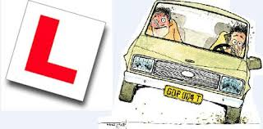
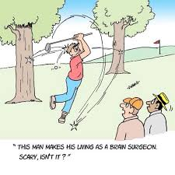


When did you last learn something new –
which didn’t involve Google, Siri or ChatGPT?

Slide 12
Effective learning - research
10% - Education: learning from teaching
20% - Exposure: learning by observing
70% - Experience:
learning by doing
Training courses
Books / journals
Webinar / Seminar
At work
Shadowing
Buddying
Job exchange
Mentoring
On the job
Coaching
Buddying
Feedback

Slide 13

Good line management in learning
Aligning expectations
Candour
Enabling and encouragement
Dealing with frustration

Slide 14

Ideas exchange
Examples to inspire:
what has been the most effective learning experience of your work/ministry?
in what learning experiences have you been able to support others?
Pitfalls to avoid:
Overpromising / under-delivering
Lack of feedback
Role creep without clarity
…

Slide 15
Questions / Comments

