Slide 1
Setting the HR foundations
Renew
Nov 2025

Slide 2

Overview
1 – Core HR (27 Nov 2025)
2 – Handling Issues (15 Jan 2026)
3 – Learning & Development (2 Feb 2026)
Raising Questions

Slide 3

Aim for today
Wider context of employment
Demystifying the role of a line manager
Laying good foundations
Framework for handling issues

Slide 4
Employee Life Cycle
Joining
Working
Leaving
Elements | Employee | Line Manager
Attraction | Why did you apply & accept? (Job, people, purpose, …) | What is the shape of the role? (Highlights, dull but necessary)
Recruitment | Impression of organisation Experience of process | Degree of complexity Speed and pressure
Onboarding | Self-directed / supported Speed | Processes, people, decision-making, belonging
Engagement | Alignment with purpose Team / people | Clarity of purpose / alignment Current belonging, future potential
Development | In current role Short and longer term goals | Skills & competences Stretch & support
Retention | Job satisfaction Alignment of personal/professional | Hygiene factors Actual and potential
Exit | Context & catalyst Process and relationships | Candour Transition support
Alumni | Impression and reputation Return / recommendation | Relationship and reciprocity Ambassador

Slide 5



Context
Policy
Employment Law
Employee Handbook
Culture
How we do things around here
Reputation & inference
Management discretion
Custom & practice
Employee circumstances
Company circumstances
Be a human being

Slide 6

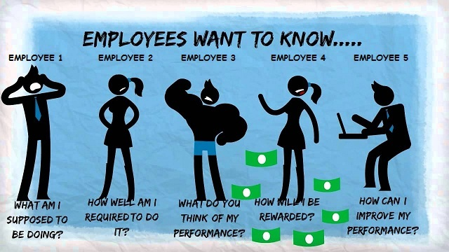


What a line manager provides
…in a church
Clarity & Direction
Appreciation & Challenge
Context & the bigger picture
Behaviours & impact – with a biblical lens?

Slide 7
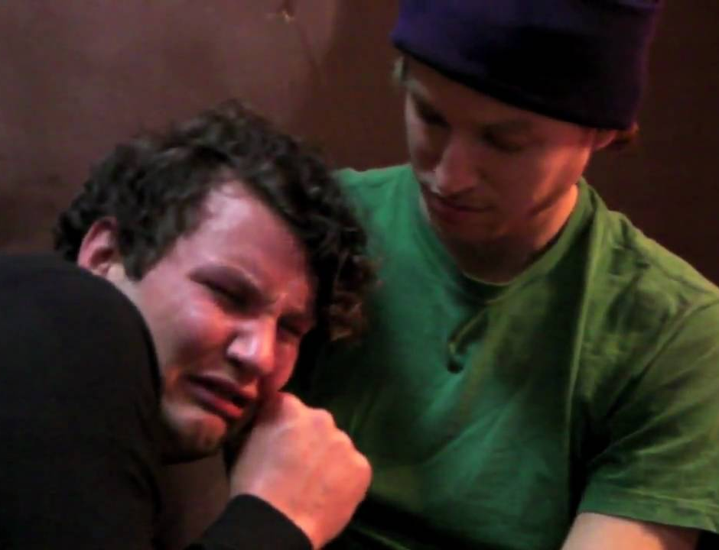

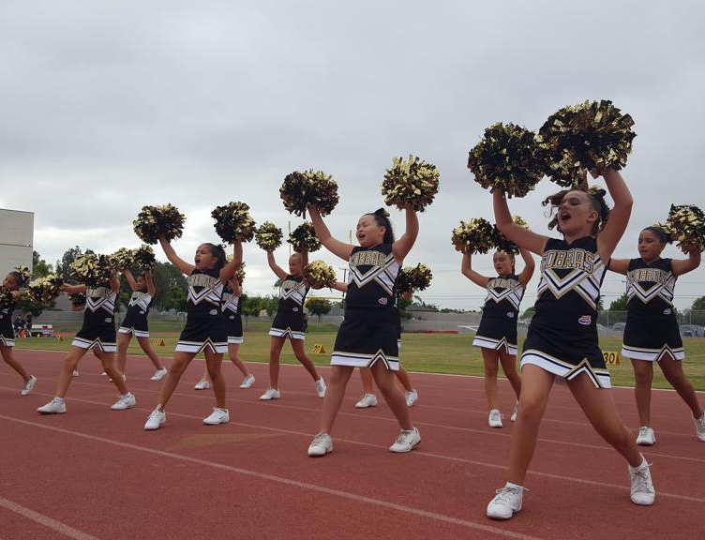

What a line manager is not
Best friend
Emotional crutch
Therapist
Superhero
Saviour
Guru
Domineering
Coercive
Self-aggrandising
Cheerleader

Slide 8
Questions / Comments

Slide 9
Annual Process cycle
Effective relationship
Communication
Feedback
Learning
Contracting
Setting Expectations
Aims / Goals
(Objectives)
Ongoing Reviews
Guiding valuable
conversations
Vision & strategy
Job description
Process documents
The Job
What
How
Looking back
Looking forward
Annual Review
Horizons
Personal / future
Team

Slide 10
Setting objectives
Organisation
Purpose/Vision/Mission
Strategy
Example
Alignment of values/purpose
What is missing without this role?
Team contribution: skills, behaviours, experience
Key priorities / trade-offs
Measurable outputs
Team
Collective
Contribution
Personal
Priorities
Projects/Tasks
Notes:
Role play? Live action?

Slide 11

Inputs
Vision / strategy
What are we focusing on as a church/ministry?
How does my role fit into the overall strategy?
Continuation / reset
What am I carrying over from previous years?
Where do I need to rethink and reset?
Team / individual
Are there others doing the same/similar role to me?
What is unique to my role?
Development
How do I want to grow and develop this year?

Slide 12

Outputs
3-6 objectives, agreed with your line manager
Clarity of what you’re aiming at
Help with managing competing priorities
Clarity to adjust / pivot if appropriate
Mix of medium and longer term – not short term
Plan for ongoing management
Regular meetings
Key check points
Measuring outcomes (mid-year, annual formal reviews)

Slide 13
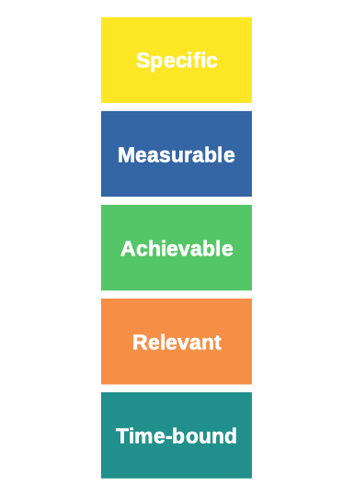
Unpacking SMART
Objective vs task: Specific, not detailed
Progress: How will you know?
Result: Could you define a good outcome?
Context: How does it fit?
Accountable: What are the horizons?

Slide 14
Example objectives
What
Get more volunteers giving talks, improve mine and disciple the group leaders
Have more time for praying and reading during regular weeks
How
Be more effective in supporting the team so they are not working too hard and enjoy their work
Personal development
Grow in contentment and trust in God

Slide 15
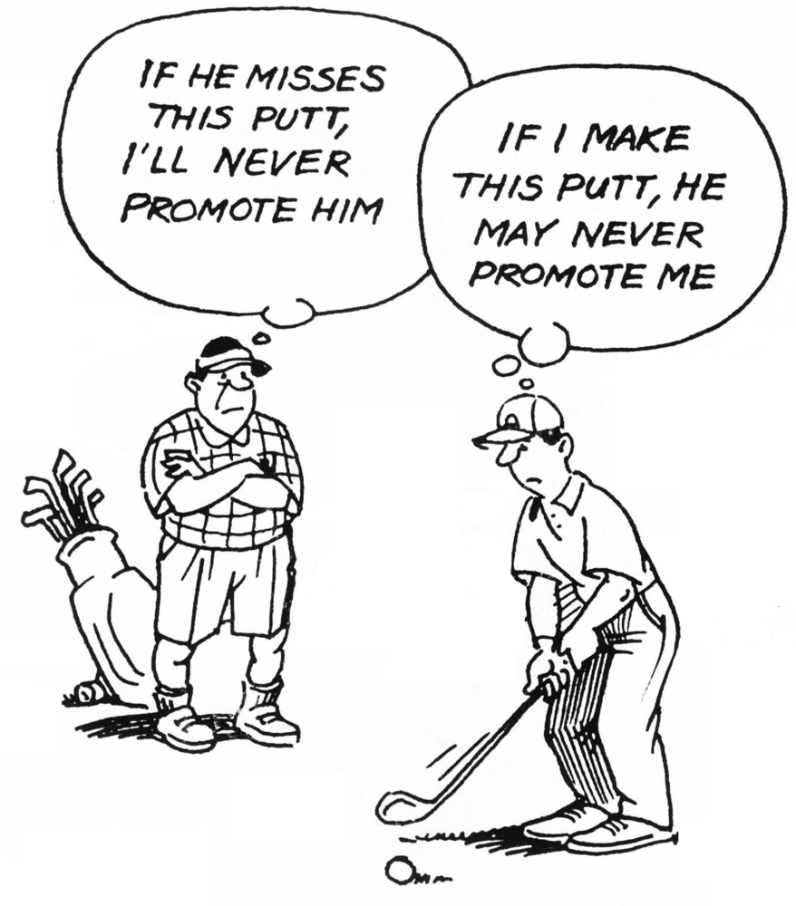
Practice
Setting Expectations
How you will work together
Alignment is 2-way; don’t be afraid to ask
Ongoing Review
Encouraging reflection: the value of questions
Feedback: who, how and so what
Working for an audience of one
Annual Review
Overview and summary of ongoing review meetings – no surprises
Looking forward: shorter and longer term
Notes:
Potential for averting future angst!
Aligning expectations – timing, content, accountability of meetings – ask them theirs and ensure shared understanding
Ask lots of open questions – if there’s been good content to the interim reviews, this should be an opportunity for more wide ranging conversation and managing potential future plans.

Slide 16
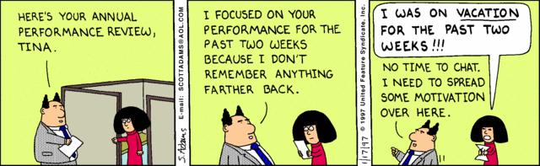
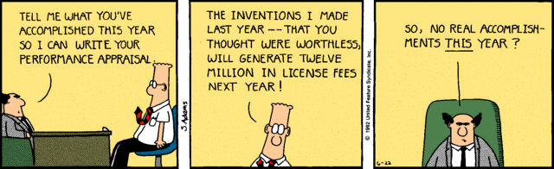
Reviews: the good, the bad and the ugly

Slide 17
Questions / Comments

Slide 18
Troubleshooting: Tools
Routine & informal
Meetings
Feedback (dynamic)
Courage & candour
Buddy/mentor
Formal
Handbook
Performance management
Grievance (employee)
Disciplinary (employer)
Appeals
External
Regulator
Police
Other

Slide 19
Troubleshooting: Triage & escalation
 | Routine Day to day | Process Informal, recorded | Process Formal | External Criminal, safeguarding, etc
Responsible | Self-leadership Team leader / line manager | Line manager | Investigation Hearing Appeal | Appropriate body (Line manager)
Actions | Conversation Feedback Check in | Clear discussion Email trail/notes | As per handbook ACAS | Report Record Follow up
Outcomes | Closure Feedback loop Buddy/mentor | Expectation reset Follow up schedule Closure | Decision / sanction Appeal | As advised

Slide 20
Summary & Next
1 – Core HR:
Context of employing people
Role of line manager
Laying foundations
Basic troubleshooting
2 – Handling Issues – routine challenges, difficult conversations, conflict
3 – Learning & Development – in small organisations

Slide 21
Questions / Comments

